Slide 1
Granular Opinion Mapping of Electric Vehicle Reviews
Using Transformers and Large Language Models
DATA 606 Capstone in Data Science - Group 10
Team Members: Satvik Reddy Singi Reddy
Bala Krishna Reddy Chinna
Manasa Jagati

Slide 2

Introduction:
• Overview: This project aims to analyze electric vehicle reviews to extract customer sentiments towards different aspects of EVs such as battery life, charging, comfort, price, and performance.
• Purpose: To assist manufacturers and policymakers in understanding public perception and identifying key areas for improvement in EV technology.

Slide 3
Project Objectives
Goals of Analyzing EV Reviews
• Understand public sentiment about electric vehicles.
• Extract and classify aspects of EVs from customer reviews.
• Identify the positive, negative, and neutral sentiments associated with specific aspects like battery life, charging, and range.
• Provide actionable insights for improving EV features based on sentiment analysis.

Slide 4
Research Questions and Background
- How does sentiment vary across different EV aspects, and what insights can be drawn from the trends?
Users generally express satisfaction with the long battery life and efficient energy consumption of electric vehicles, but concerns about range anxiety, battery degradation over time, and poor performance in cold weather are common negative sentiments, highlighting the need for longer ranges, faster charging, and improved reliability in extreme climates. While fast-charging stations and home charging options receive positive feedback, the lack of sufficient public charging infrastructure, long wait times, and compatibility issues between charging networks remain significant drawbacks, underscoring the importance of expanding charging networks, especially in rural areas, and adopting universal charging standards. Additionally, cost and affordability continue to influence consumer sentiment, with high upfront costs acting as a barrier to adoption, suggesting that competitive pricing, government incentives, and reduced maintenance costs could make EVs more accessible to a broader audience.

Slide 5
Dataset Information
This study utilized synthetic customer reviews generated through OpenAI's GPT-4.0 model to perform a comprehensive sentiment analysis of electric vehicle (EV) features. These reviews simulate diverse consumer perspectives, offering detailed insights into aspects such as battery life, charging infrastructure, cost, and environmental impact.

Slide 6
How the Data Was Created:
Advanced Language Modeling: OpenAI's GPT-4.0 was used to generate detailed reviews that reflect varied opinions, capturing both positive and critical feedback.
Custom Prompts: Specific prompts were designed to ensure the reviews address all key EV features and provide meaningful data for analysis.
Balanced Sentiments: The reviews include a diverse mix of positive, neutral, and negative sentiments for comprehensive aspect-based analysis

Slide 7
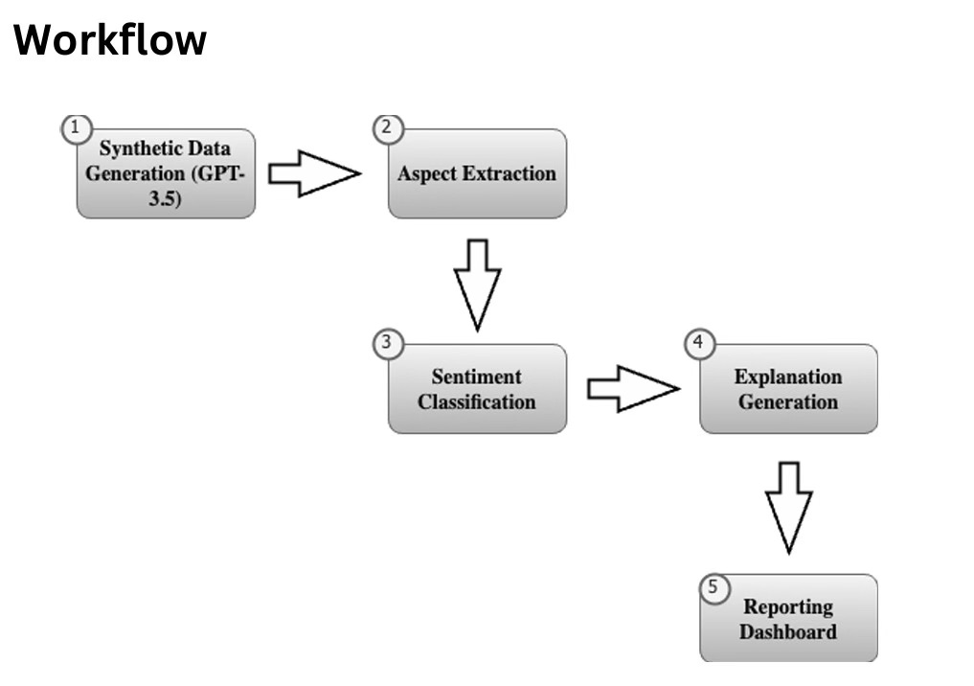
Workflow Diagram

Slide 8
Workflow
Data Sources: The sentiment analysis tool relies on two primary data sources
Generated Reviews: Utilizing OpenAI's GPT-4.0 through LangChain, the tool synthesises reviews that simulate public opinion on various EV features, including battery life, range, charging capability, and comfort.
Sentiment Analysis Model: The distilbert-base-uncased-finetuned-sst-2-english model from Hugging Face is employed to classify sentiments within each review.
Aspect Extraction: The language model identifies and extracts aspects related to EV features.
Sentiment Classification: Each aspect is classified into positive or negative sentiments using he pre-trained sentiment model.
Explanation Generation: Detailed explanations summarize the review and the sentiments for each aspect.
Reporting & Dashboard: Provided with an interactive dashboard for continuous monitoring, featuring insights visualized through Altair and Plotly, including bar charts, pie charts, and line graphs

Slide 9
Tools and Technologies
Technologies Used for EV Review Analysis
Language Models & Transformers: GPT-4,0 for generating reviews, Hugging Face models for aspect extraction.
Sentiment Analysis Pipeline: DistilBERT used for classifying sentiments into positive, neutral, and negative categories.
Dashboard & Visualization Tools: Streamlit for the interface, Altair and Plotly for interactive charts.

Slide 10
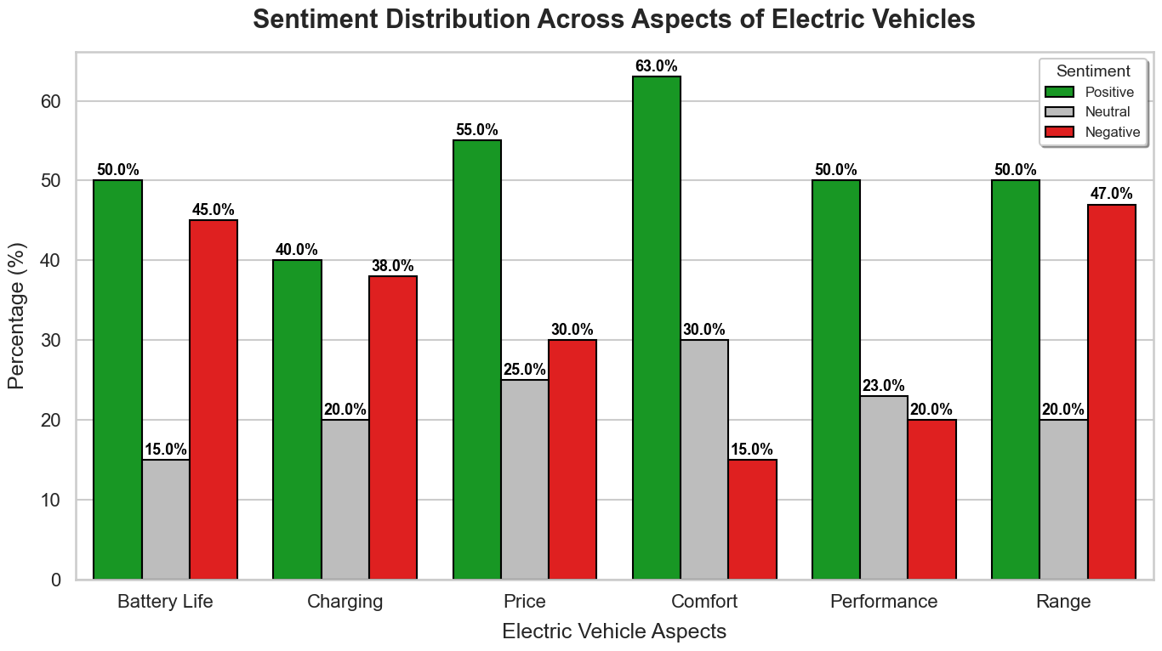
Sentiment Distribution Across Aspects
Understanding Customer Opinions on EV Features
Battery Life and Comfort received predominantly positive feedback.
Mixed sentiments observed for Charging and Range, indicating room for improvement.
Price was a divisive factor, with both appreciation for value and concerns about affordability.

Slide 11
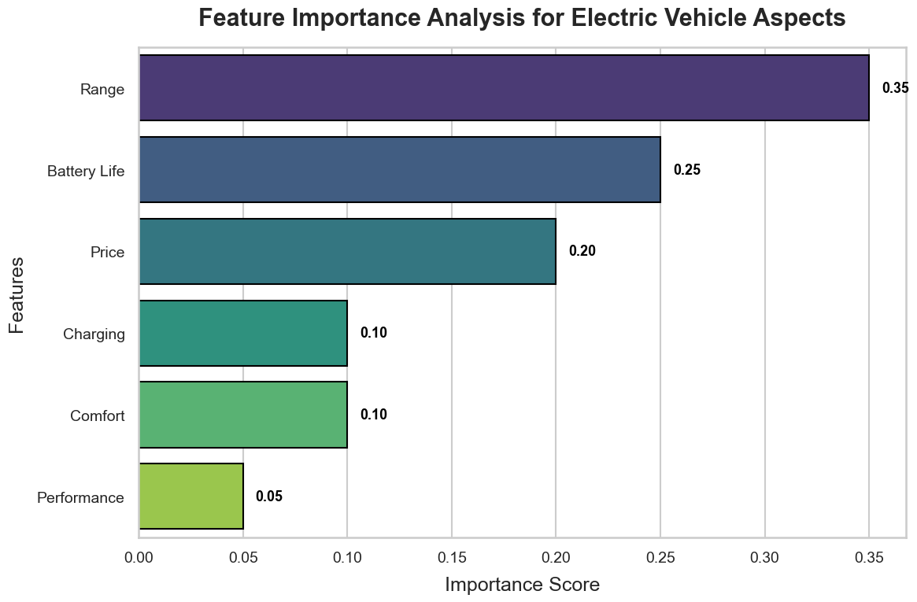
Feature Importance Analysis
Key Features Influencing Customer Satisfaction
Analysis of the importance of various EV features in influencing overall customer satisfaction.
Insights:
Range and Battery Life were found to be the most significant features.
Price and Performance were also critical but showed mixed influence on customer perception.

Slide 12
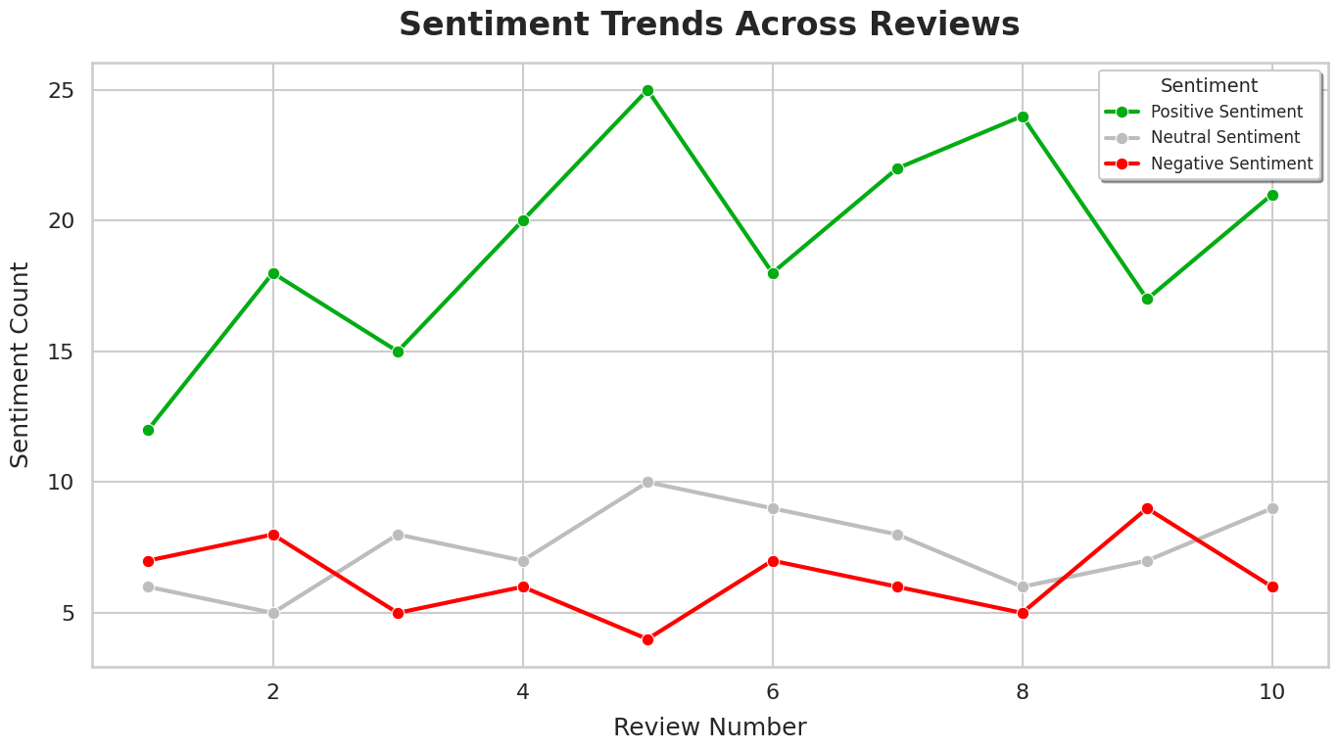
Sentiment Trends Across Reviews
Sentiment Variation Across Customer Reviews
Analysis of sentiment trends across multiple customer reviews.
Insights:
Positive sentiments fluctuated across reviews, indicating varied experiences among customers.
Negative sentiments were observed for aspects like Charging and Price.

Slide 13
Challenges
Issues Encountered During the Project
No Static EV Reviews Dataset: One of the primary challenges faced during the project was the lack of a publicly available, comprehensive dataset for electric vehicle (EV) reviews. No static dataset exists that consistently covers the necessary aspects such as battery life, range, price, and performance.
Ensuring Data Authenticity: Another challenge was maintaining the authenticity and usability of synthetic reviews to mimic real-world scenarios effectively, which required fine-tuning and validation.
Model Limitations: Sentiment analysis models occasionally struggled with nuanced or mixed opinions, often misclassifying sentiments where the context was ambiguous. This limited the overall accuracy of aspect-based sentiment analysis.

Slide 14
Future Improvements
Enhancing the Sentiment Analysis Model
Model Enhancement: Fine-tune sentiment analysis models for better accuracy in classifying nuanced customer sentiments.
Broaden Data Sources: Incorporate real customer reviews from multiple platforms to improve data diversity.
Product Development: Introduce "EV Insight Pro" as a potential product for manufacturers and policymakers to gain real-time insights.

Slide 15
Conclusion
Insights and Future Directions
Key Insights:
The project successfully demonstrated how aspect-based sentiment analysis can provide actionable insights into public opinion about electric vehicles. By focusing on aspects like Battery Life, Comfort, Charging Speed, and Price, we identified key strengths and areas for improvement, highlighting the potential to better align EV features with customer expectations.
Significance:
Insights such as the strong reception of Battery Life and Comfort and the need to address concerns about Charging Speed and Price empower EV manufacturers to prioritize innovation effectively.
Future Directions:
Moving forward, the model will be refined to handle nuanced sentiments and incorporate a broader range of real-world customer reviews. Expanding datasets and improving analysis techniques will strengthen its applicability for stakeholders.

Slide 16
THANK YOU

